Slide 1
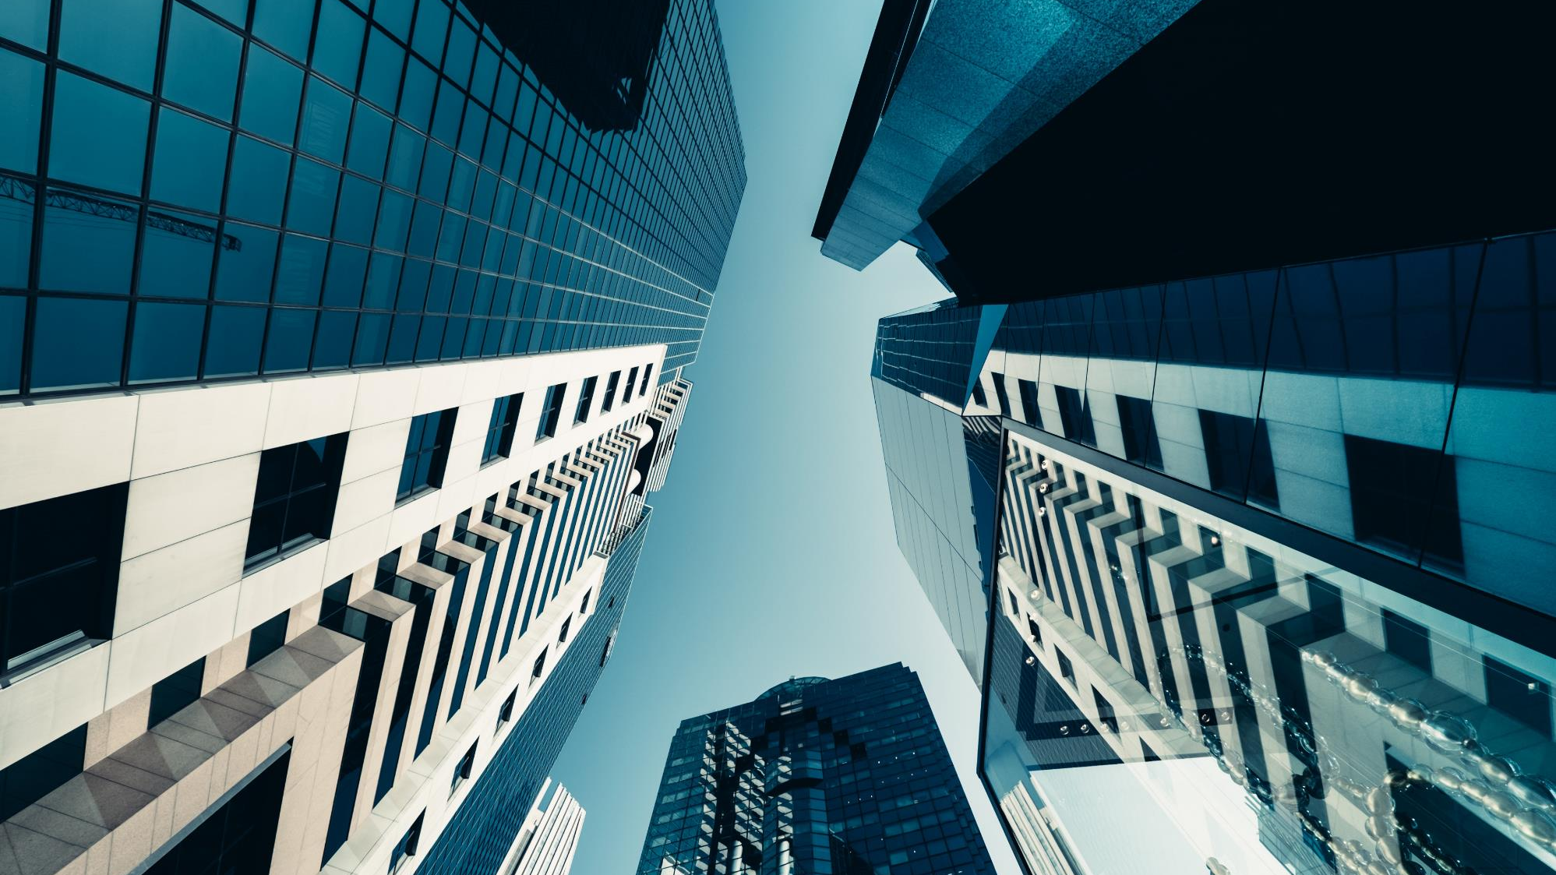
Self Supervised Approach to Classify Eye Fundus Images
Guide : Kriti Ohri
By:
A. Siddhartha (19071A3201)
A. Shruthika (19071A3202)
G. Nihanth (19071A3217)
M. Dineswar (19071A3230)

Slide 2
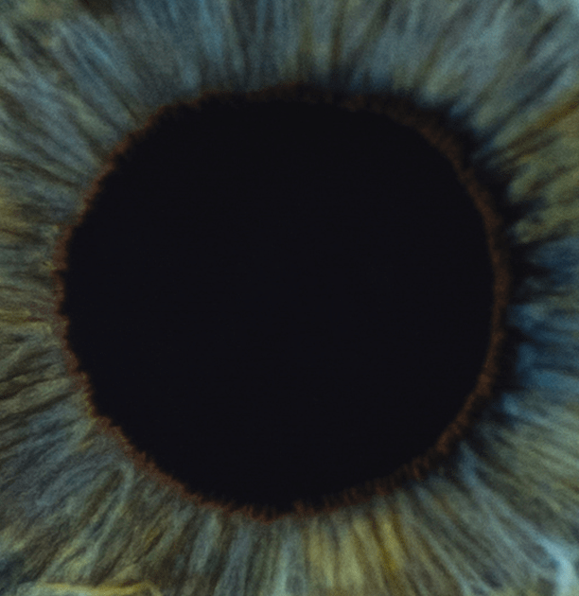
Agenda
Learning from limited labeled data for medical image analysis
Evaluate the performance of downstream classification tasks using ImageNet pretrained features obtained from supervised and self-supervised techniques
Assess the quality of the embeddings obtained from different models which are pretrained on ImageNet using state-of-the-art self-supervised or supervised pretraining techniques.

Slide 3
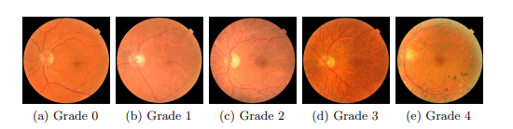
Abstract
Diabetic retinopathy (DR) is a type of ocular disease that can cause blindness due to damaged blood vessels in the back of the eye. The causes of DR are high blood pressure and high blood sugar concentration, which are very common in modern lifestyles. People with diabetes usually have higher risks of developing DR. In fact, one-third of diabetes patients show the symptoms of diabetic retinopathy according to recent studies. Therefore, early detection of DR is critical to ensure successful treatment. Unfortunately, detecting and grading diabetic retinopathy in practice is a laborious task, and DR is difficult to diagnose at an early stage even for professional ophthalmologists. As a result, developing a precise automatic DR diagnostic device is both necessary and advantageous.
Automated DR diagnosis systems take retinal images (fundus images) and yield DR grades. In the common retinal imaging dataset of DR, the grades of DR can be categorized into five stages: 0 - no DR, 1 - mild DR, 2 - moderate DR, 3 - severe DR, and 4 - proliferative DR. Specifically, the severity of DR is determined by taking the numbers, sizes, and appearances of lesions into account. For instance, the figure below provides an illustration of five DR grades in the Kaggle DR dataset. As can be seen, the characteristics of DR grades are complex in both structure and texture aspects. Therefore, automated diagnosis systems are required to be capable of extracting meaningful visual features from retinal images for precise DR grading.

Slide 4
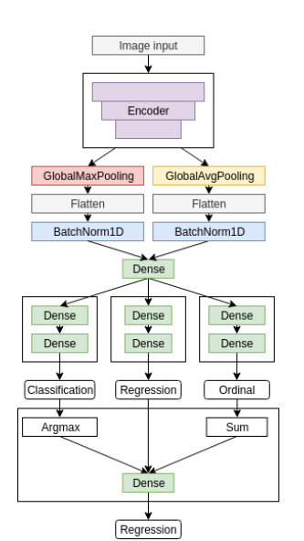
Existing Systems
All the existing systems for the classification of the diabetic retinopathy are supervised.
Supervised Techniques
Shaohua Wan, Yan Liang, Y. Z. (2018). Deep convolutional neural networks for diabetic retinopathy detection by image classification.
Borys Tymchenko, Philip Marchenko, Dmitry Spodarets (2020)Deep Learning Approach to Diabetic Retinopathy Detection

Slide 5
Drawbacks
Data Annotation
The scarcity of high-quality annotated data remains a notorious challenge in medical image analysis due to the high cost of acquiring expert annotations
Scalability
Supervised learning requires labeled data to predict outcomes for unknown data. However, it can need large datasets to build proper models and make accurate predictions. For large training datasets, manual data labeling can be challenging. Self-supervised learning can automate this process and handle this task with even massive amounts of data.

Slide 6
Proposed System
Using the self-supervised techniques and use it for the downstream task of diabetic retinopathy classification
SIMCLR
Simple Framework for Contrastive Learning of Visual Representation Chen et al. [2020] maximizes the agreement of two views from the same image. The paper proposes a set of transformations applied to input images to create positive and negative pairs. An encoder takes a transformed batch and forwards it to a projection head that maps images to an embedding space. A contrastive loss on top compares the embeddings to minimize the distance between similar (positive) embeddings. Finally, the projection head is discarded and the encoder can be transferred to downstream tasks.
SWAV
Swapping Assignments between multiple Views of the same image Caron et al. [2021a] also contrasts two image views but not in a direct, sample-based fashion as SimCLR. Instead, it compares the cluster to which each view belongs. If two views come from the same image, they should fall on the same cluster assignment and vice versa. Caron et al. Caron et al. [2021a] shows that this approach has an advantage over SimCLR in avoiding the need for large batch size and improving the convergence time. In comparison to a prior clustering-based self-supervised technique in Caron et al. [2019], the clustering assignment process is online, so gradients can be backpropagated in batch-wise manner.

Slide 7
Proposed System
DINO
Knowledge distillation without labels Caron et al. [2021b] matches the output probability distributions of various image views obtained from two networks. This approach takes inspiration from Bootstrap Your Own Latent (BYOL) Grill et al. [2020] in the perspective of self distillation task and the architecture of Vision Transformer (ViT) Dosovitskiy et al. [2021] as the backbone. Instead of passing the views into the same network, DINO passes two transformations of an image into two networks, namely the student and teacher network. The loss compares the probability outputs of both networks and the student’s parameters are updated via backpropagation while the teacher’s parameters is updated via an exponential moving average of the student ones. In addition, compared to using convolutional architectures, Caron et al.’s study Caron et al. [2021b] indicates that ViT-based DINO shows distinct properties in characterizing object boundaries and generates features that perform well using K-Nearest Neighbors without further finetuning in ImageNet classification task.
An ensemble of the self-supervised representation using an attention module to improve the accuracy of the classification.

Slide 8
Methodology
To assess the transferability of self-supervised features in medical imaging tasks, choose ResNet-50 He et al. [2015], which is the backbone for many state-of-the-art self-supervised approaches Chen et al. [2020], He et al. [2020], Caron et al. [2021b, a]. ResNet-50 is used for the supervised baseline (ImageNet and random initialization) and two self-supervised approaches (SwAV and SimCLR). For Dino, the architecture of choice is VisionTransformer (ViT) with patch size 88. The pretrained weights for SimCLR and SwAV are obtained from VISSL while for DINO the weights are obtained from the FAIR repository.

Slide 9
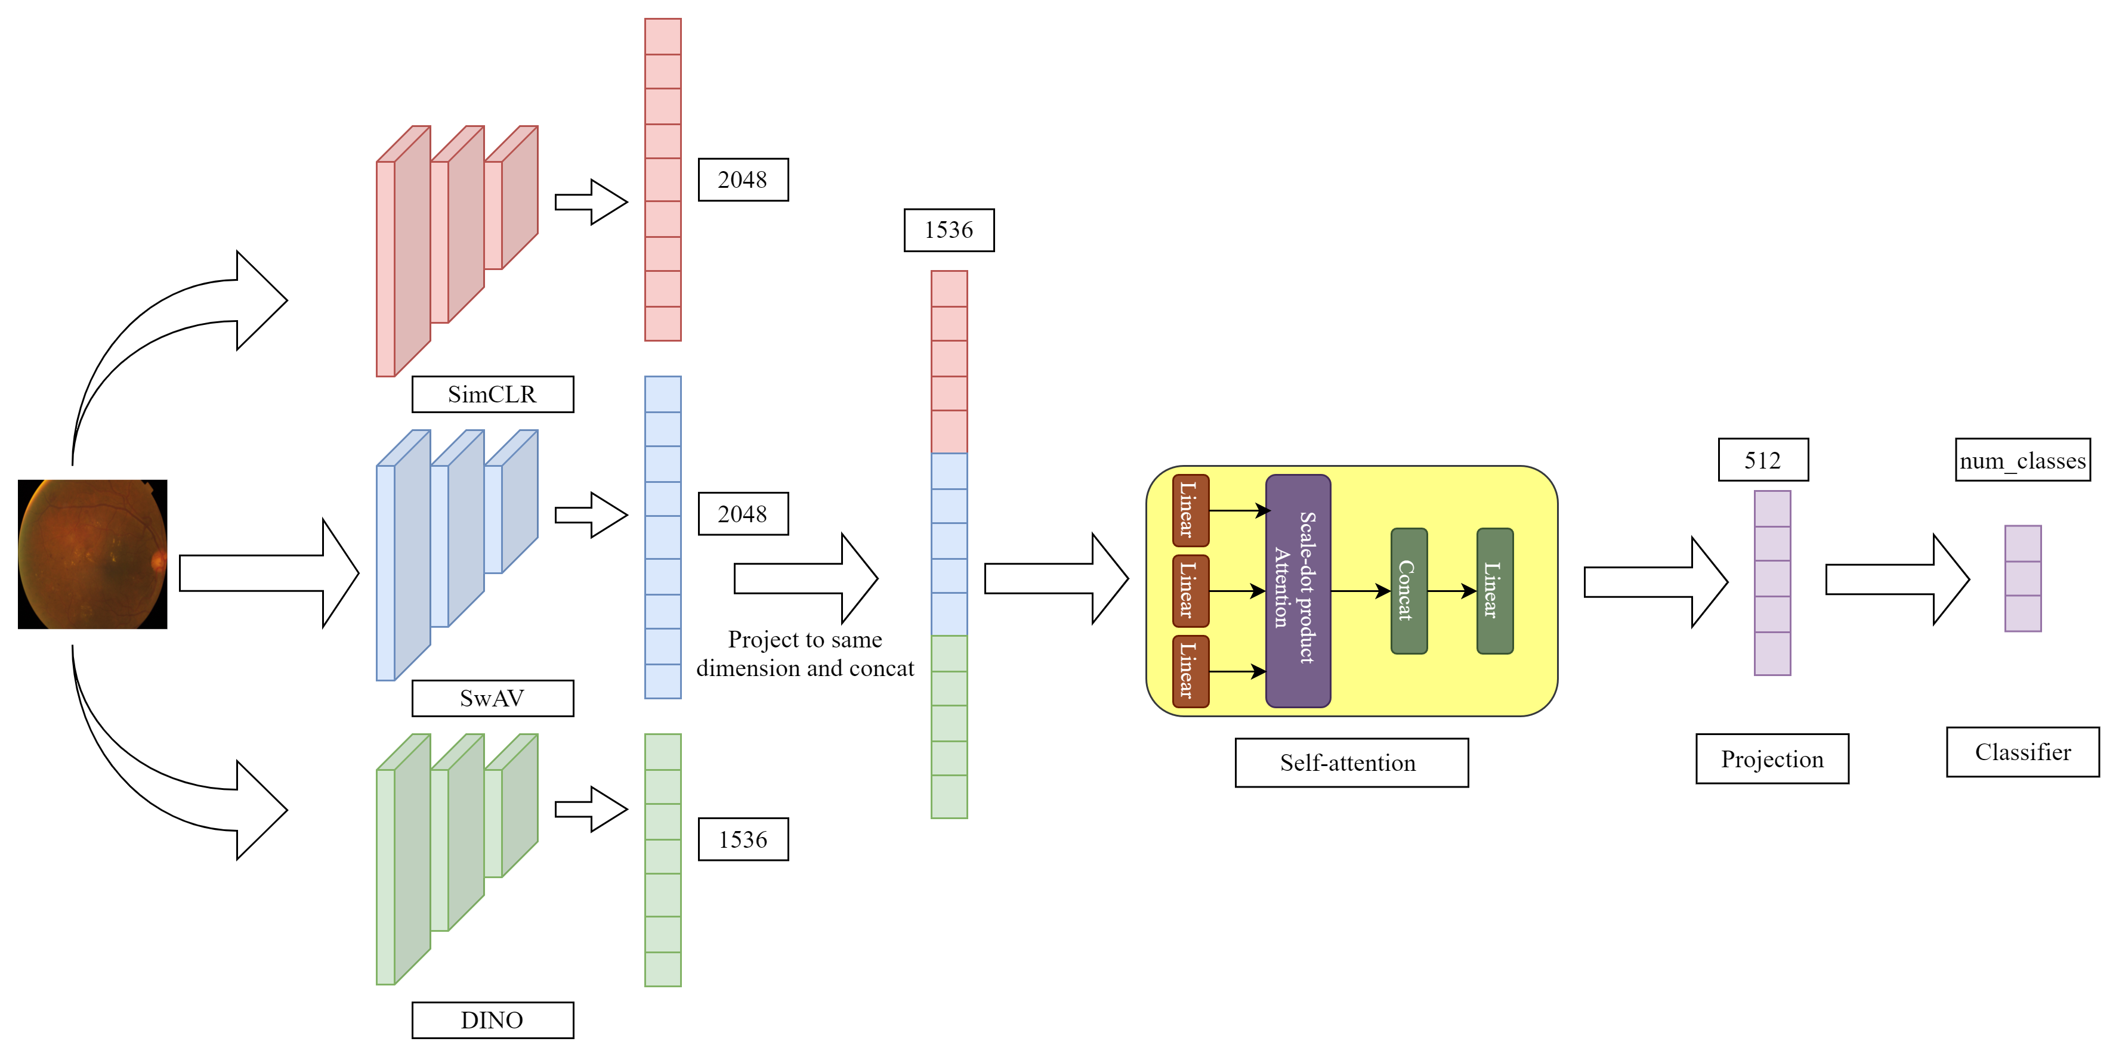
Model Architecture

Slide 10
System Requirements
Processor: 6-8 core processor
OS : Windows or Linux
Memory: 16-32GB RAM
Storage: 256GB or 512GB of SSD storage.
GPU: GPU compatible with cuda toolkit and cudNN library preferably Nvidia Tesla P100’s or higher

Slide 11
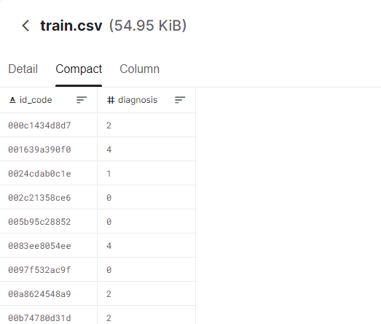
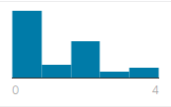
Dataset Architecture
Class Distribution

Slide 12
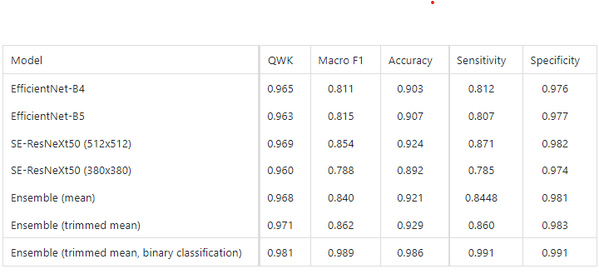
Supervised Literature
Deep Learning Approach to Diabetic Retinopathy Detection
Borys Tymchenko, Philip Marchenko and Dmitry Spodarets
3 Mar 2020

Slide 13
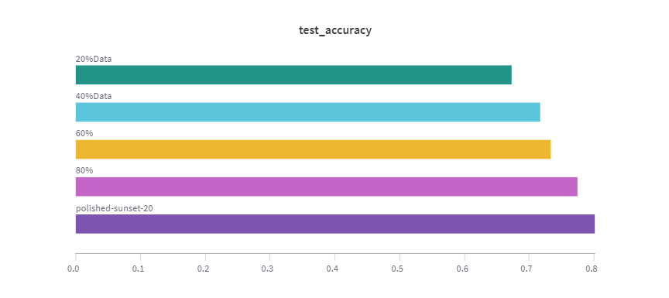
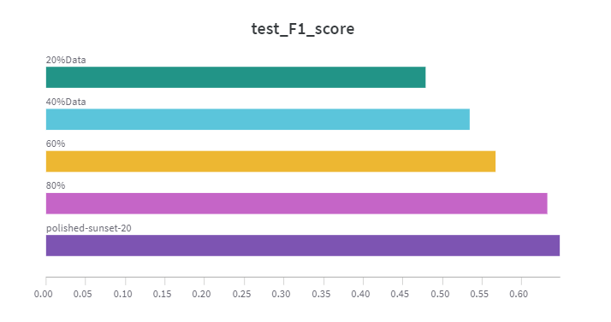
Supervised Results
https://wandb.ai/dineswar_alt/Aptos_

Slide 14
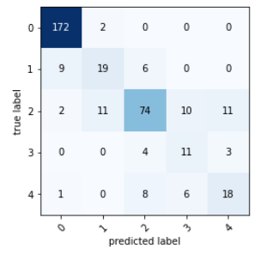
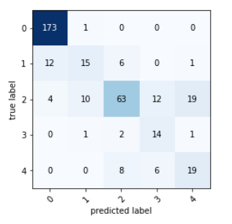
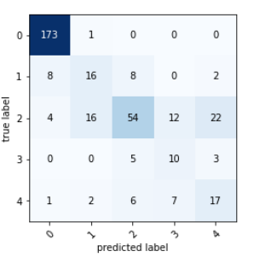
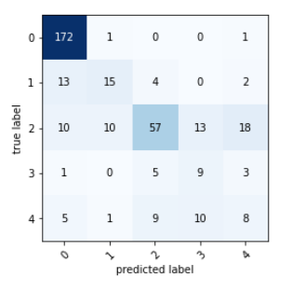
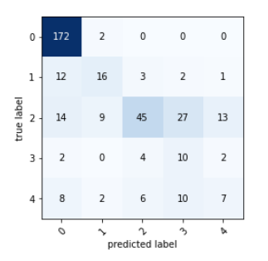
Confusion Matrix
Full data
80% data
60% data
20% data
40% data

Slide 15
Self –Supervised Techniques
The motivation behind Self-supervised learning is to learn useful representations of the data from unlabelled pool of data using self-supervision first and then fine-tune the representations with few labels for the supervised downstream task. The downstream task could be as simple as image classification or complex task such as semantic segmentation, object detection, etc.
Contrastive Methods
Non Contrastive Methods
SimCLR
Barlow Twins
SwAV
BYOL
DINO

Slide 16
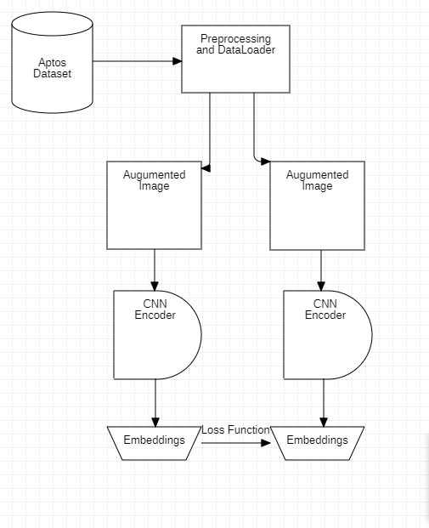
Self –Supervised Contrastive Workflow
Contrastive Self Supervised Learning
In contrastive learning the positive and negative images are processed by the same model
The basic intuition is that the embedding of images of the same class must to closer to embeddings of images with the same class than the other class
Using the above intuition we use different loss functions which represents the similarity between these two embeddings
Using this loss we back prop to the CNN encoder and updating the weights
The problem with using CSSL is they may reach trivial solutions or need large batches thus more RAM to process the negative samples

Slide 17
Self –Supervised Non Contrastive Workflow
Contrastive Non Self Supervised Learning
In non contrastive learning only the positive samples are processed by the two different model
The 2 different models “Student Model” and “Teacher Model”
The updating of the weights is done by using distillation
The loss function is “closeness” between the embedding of the teacher and the student model

Slide 18
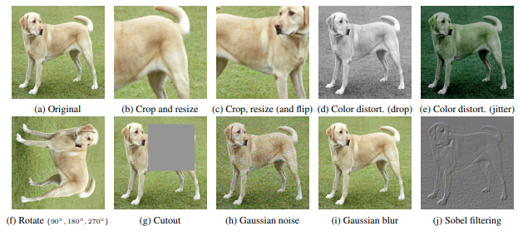
Self –Supervised Workflow Augmentation

Slide 19
Self–Supervised Literature
Title | Year of Publication | Model | Methods | Advantages / Limitations
A Simple Framework for Contrastive Learning of Visual Representations | ICML 2020 | SimCLR | Contrastive Method | Advantages Simple Framework Disadvantages Needs more negative Samples and more memory
Barlow Twins: Self-Supervised Learning via Redundancy Reduction | Mar 2021 | Barlow Twins | Contrastive Method | Advantages Less dependent on Augmentation Disadvantages Dimensionality collapse and trivial solution

Slide 20
Self–Supervised Literature
Title | Year of Publication | Model | Method | Advantages / Limitations
Unsupervised Learning of Visual Features by Contrasting Cluster Assignments | NeurIPS 2020 | SWaV | Contrastive Method | Advantages Clusters the Embedding's for a better loss function Disadvantages Needs more negative Samples and more memory
Emerging Properties in Self-Supervised Vision Transformers | ICCV 2021 | DINO | Non Contrastive Method | Advantages Does not Need negative samples Disadvantages Scales badly with higher dimensions.

Slide 21
UML Diagrams

Slide 22
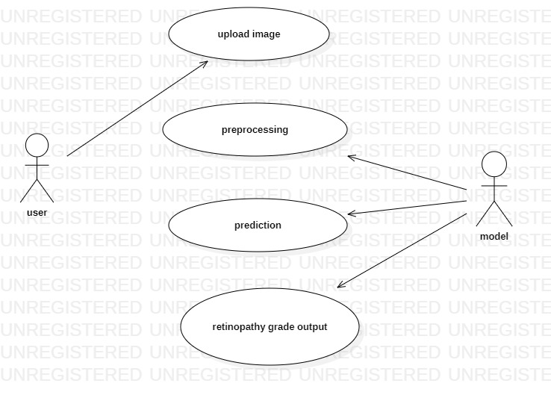
Use Case Diagram

Slide 23
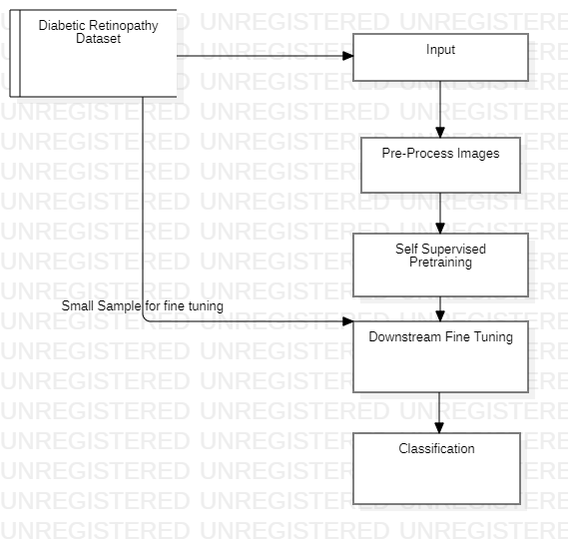
Data Flow Diagram

Slide 24
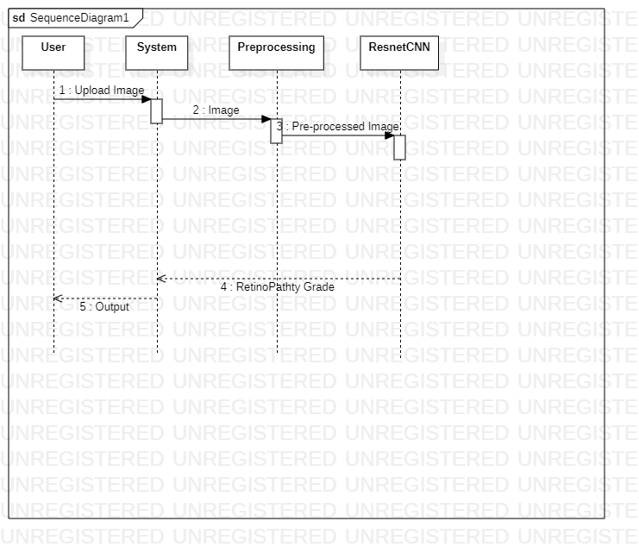
Sequence Diagram

Slide 25
Results

Slide 26
Experiments
We performed the above shown techniques on 2 diabetic retinopathy datasets
Aptos (contains 3662 images)
Eyepacs (contains 30,000 images)
We first train the model with imagenet initialization on the datasets and then finetune to get the maximum accuracy for the given problem
And comparing the accuracy to supervised techniques
Using Eyepacs (30k images) also shows how easily it is scalable to more data

Slide 27
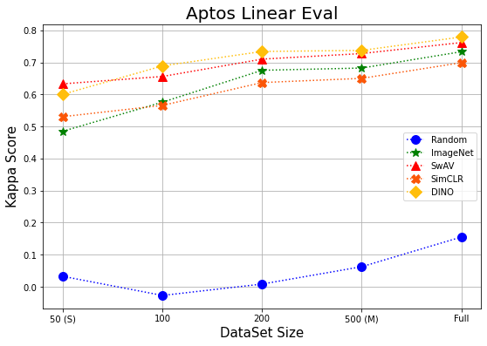
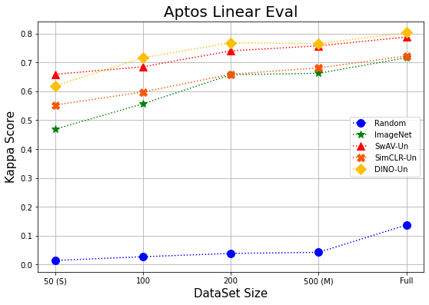
Aptos Linear Eval

Slide 28
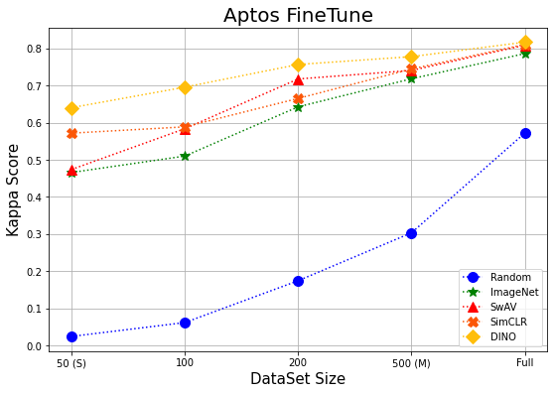
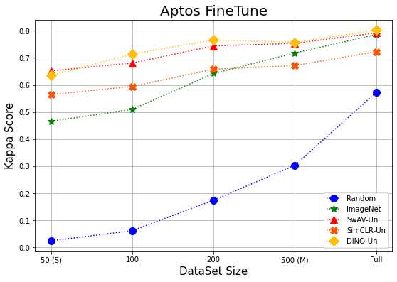
Aptos Fine Tune

Slide 29
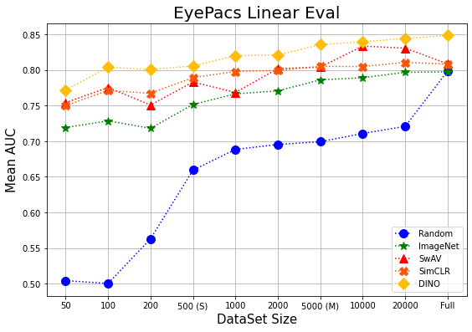
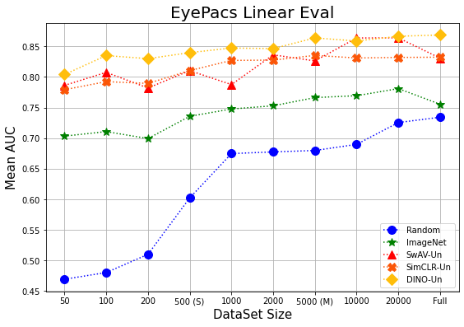
EyePacs Linear Eval

Slide 30
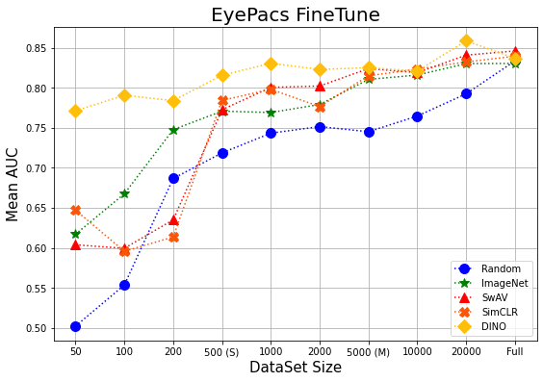
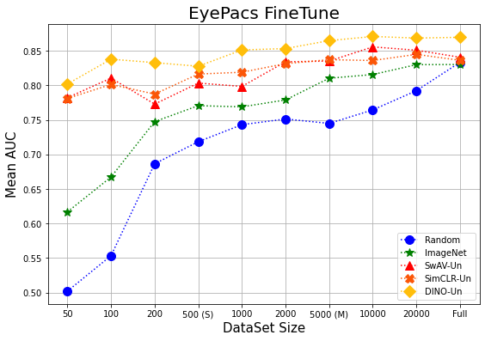
EyePacs FineTune

Slide 31
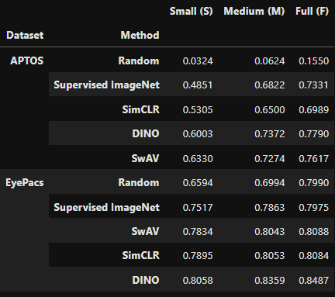
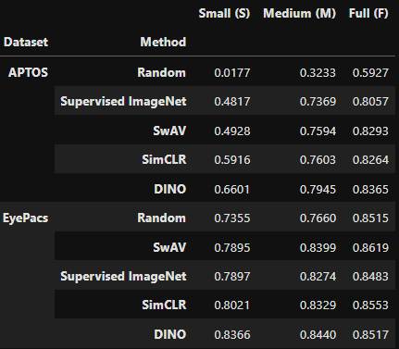
Results using proposed system
Linear Eval
Fine tune

Slide 32
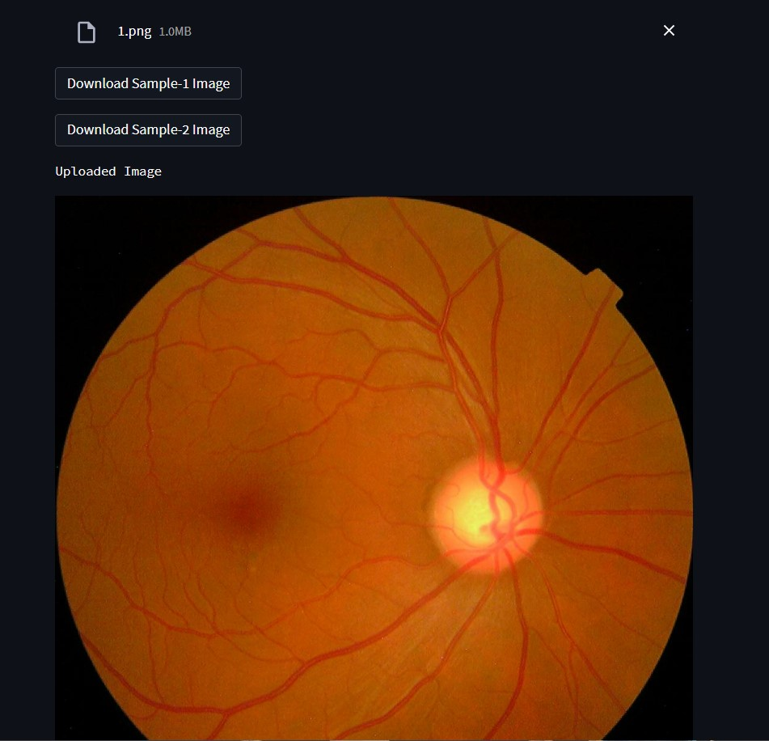
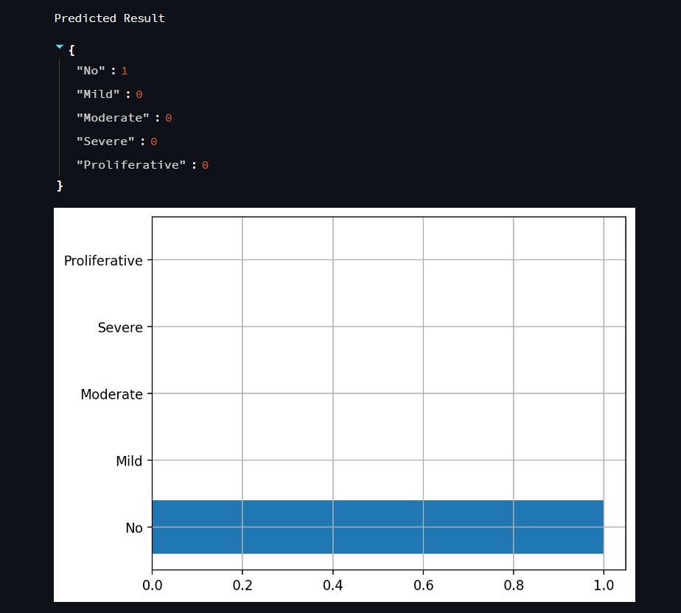
Model Explain ability
Web Demo

Slide 33
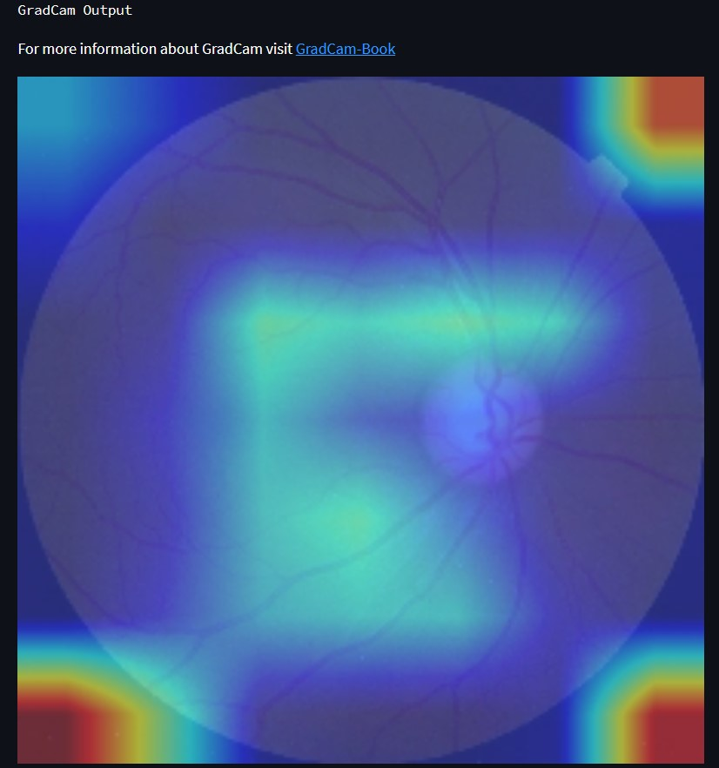
Model Explain ability
Web Demo
Model Explain ability plays in huge role in deep learning models as they are know to be black boxes
After analysis some of the outputs (next slide) we find out that Diabetic Retinopathy is more of image Segmentation problem than Image classification
So we would like to continue our project to image segmentation for major project

Slide 34
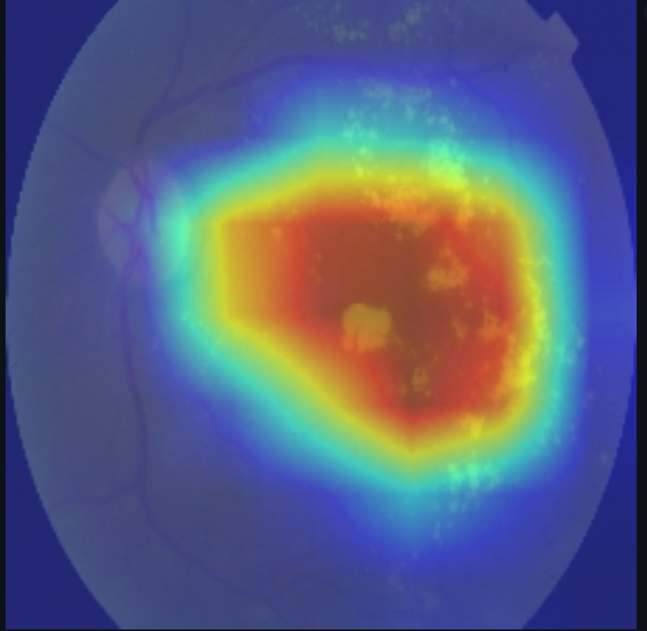
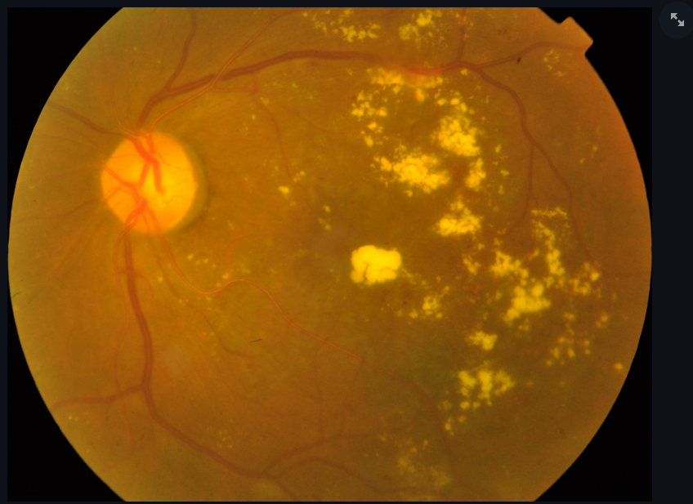
Model Explain ability
Web Demo
Model Explain ability plays in huge role in deep learning models as they are know to be black boxes
After analysis some of the outputs (next slide) we find out that Diabetic Retinopathy is more of image Segmentation problem than Image classification
So we would like to continue our project to image segmentation for major project

Slide 35
..

